Slide 1

HOME ACCENT REMEDIES
Masonry. Heritage. Transformation.
Over 25 Years of Trusted Craftsmanship in Brick, Stone, and Outdoor Design.

Slide 2

Who We Are
A Family-Owned Legacy, Powered by the Accent Group
At Home Accent Remedies, we’re more than just expert masons — we’re a family-owned business that has proudly served communities across the United States for over 25 years. As a division of the Accent Group, we carry the strength and support of a larger organization while staying true to the core values of craftsmanship, personal service, and generational expertise passed down within the Padilla family.
Our work is where tradition meets innovation. For three generations, masonry has been in our blood — shaping not just structures, but legacies. Whether we’re laying a brick, carving a stone, or designing a custom entryway, every detail reflects our pride in our work and our passion for homes that inspire.

Slide 3
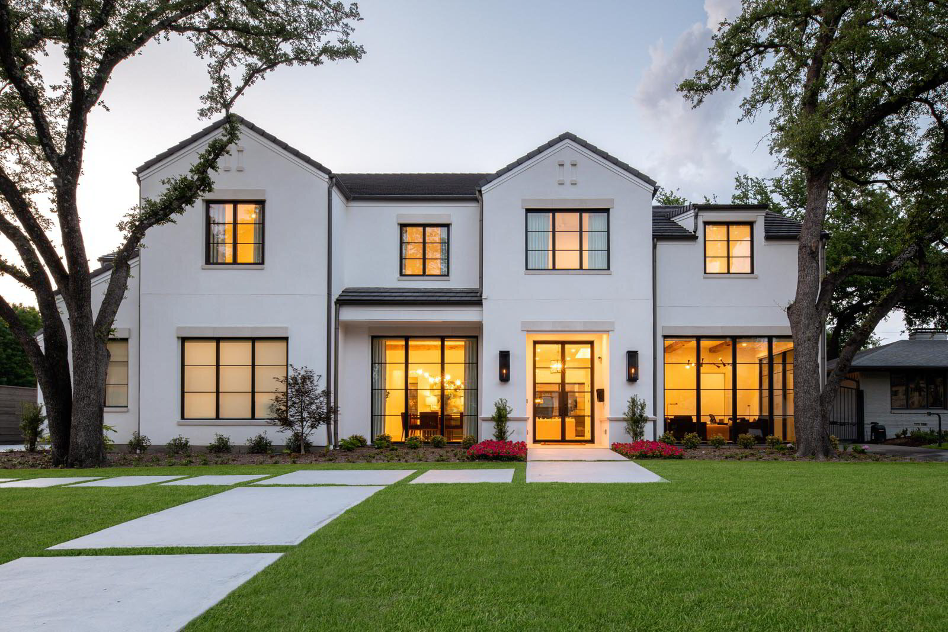
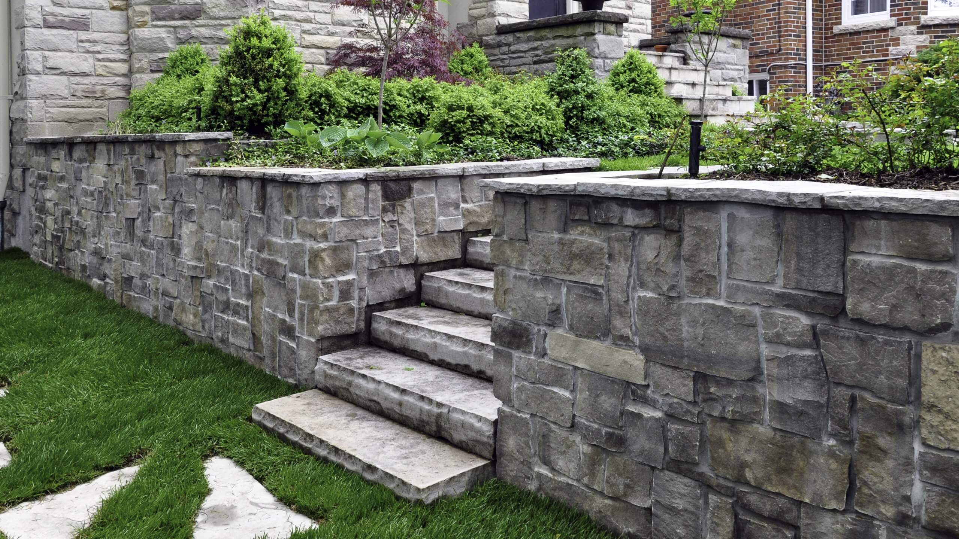

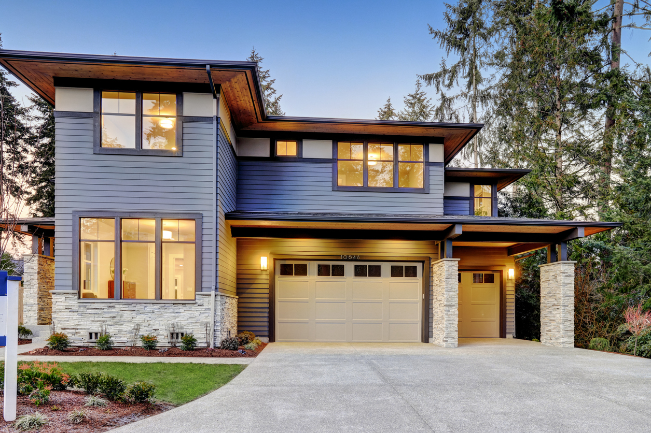
What We Specialize In
We enhance the beauty and value of residential architecture through:
Custom Brick & Stone Accents that align with your home’s unique architectural style
Thin Brick Veneers & Stone Facades that add elegance and texture
Walkways, Driveways & Paver Solutions designed for beauty and durability
Landscape-Integrated Masonry to boost curb appeal and create harmony between nature and structure
Complete Exterior Transformations, tailored to your vision and lifestyle

Slide 4
A Legacy of Trust — Backed by the Accent Group
As a proud member of the Accent Group family of companies, Home Accent Remedies delivers the personalized service of a small family business with the resources, accountability, and reliability of a larger enterprise.
This partnership allows us to maintain the intimate feel of a family-run team, while benefiting from the operational excellence, safety standards, and innovation support that only a larger parent group can provide.
Why Homeowners and Employees Choose Us
✔ Family-Owned Values: We treat your home as if it were our own
✔ Generational Craftsmanship: Built on techniques and traditions refined over 3 generations
✔ National Reach, Local Feel: Serving homes across the U.S. with care and consistency
✔ Accent Group Backing: A name synonymous with quality and operational integrity
✔ Commitment to Growth: We invest in our people and our processes — from the ground up

Slide 5
A Legacy of Trust — Backed by the Accent Group
Whether you’re upgrading your front entry with stunning stonework or reimagining your outdoor space with durable, elegant pavers — Home Accent Remedies brings the skill, experience, and heart to make it happen.
We don’t just build — we create.
We don’t just finish projects — we build relationships.
And we don’t just deliver results — we stand behind them.
Let us show you what it means to be part of the Accent Group INC. — and part of something built to last.

